Slide 1
Alzheimer’s Disease and the influence of Presenilin 1
By Tony Cortez

Slide 2
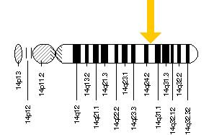
What is PSEN1?
Presenilin 1 Gene
Neurological regulatory gene
Encodes for the presenilin 1 protein
Regulates APP production
Controls amyloid plaque and neurofibrillary tangle formation
Human Chromosome 14
Notes:
No bullet points
Introduce what APP is
Pathway picture: http://www.jci.org/articles/view/25100/figure/2

Slide 3
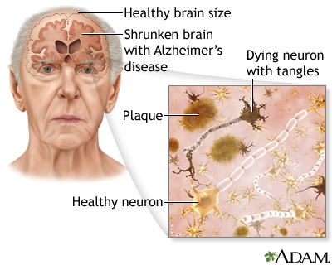
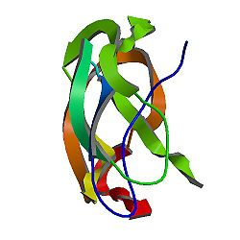
How is PSEN1 involved in Alzheimer’s?
Mutated PSEN1
Alzheimer’s Disease
Overproduction of APP

Slide 4
What is Alzheimer’s Disease?

Slide 5
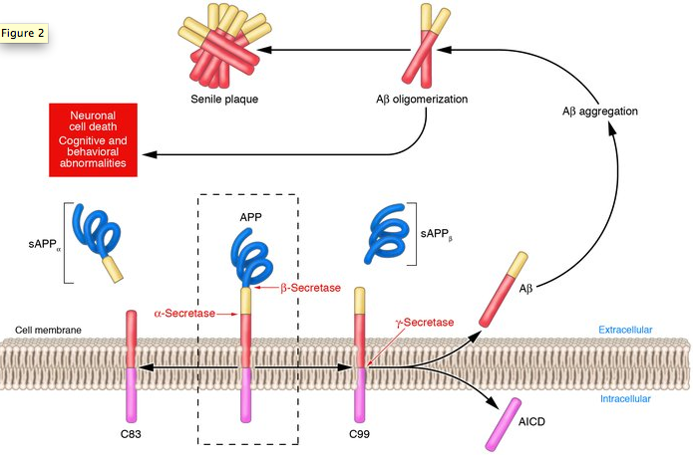
What goes wrong in Alzheimer’s?
Memory loss
Speech impediment
Disorientation
Notes:
No bullet points
Introduce what APP is
Pathway picture: http://www.jci.org/articles/view/25100/figure/2

Slide 6
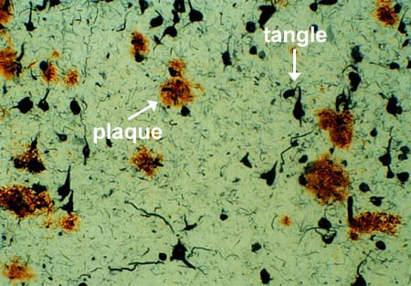
How is APP involved in Alzheimer’s?
Neurofibrillary Tangles
DEGRADATION
Amyloid Plaques
Amyloid Precursor Protein

Slide 7
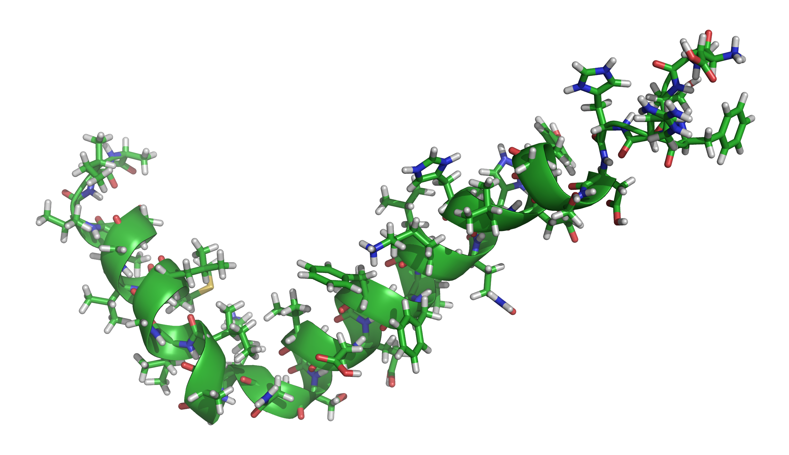
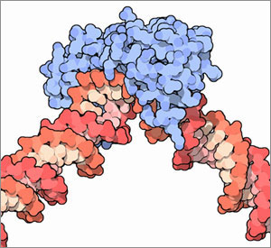
How is PSEN1 sorted with Gene Ontology?
PSEN1
Biological Process
Molecular Function
Cellular Component
Beta-amyloid formation
Cell differentiation
Neurotransmission regulation
Brain development
Transmembrane transport
Transcription factor binding
Kinase activity
Gamma-secretase complex
Dendritic roots
Regulatory protein complexes
Notes:
http://upload.wikimedia.org/wikipedia/commons/7/74/Amyloid-beta-42_1IYT.png
http://www.broadinstitute.org/files/news/stories/full/TF_wikimedia.jpg

Slide 8
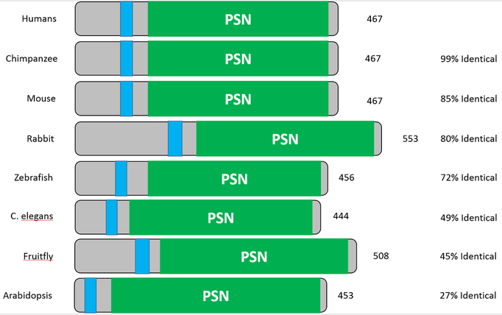
How is PSEN1 conserved across organisms?

Slide 9
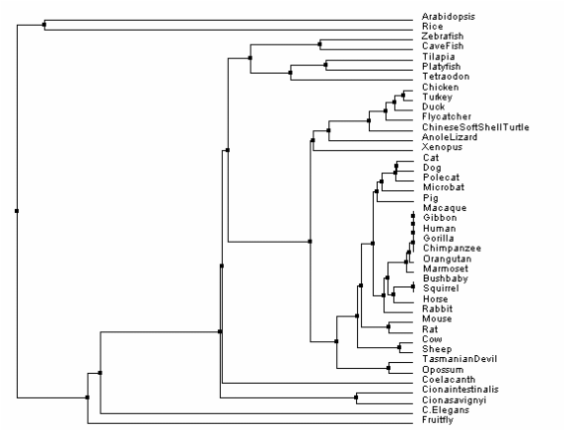
Phylogeny: How is PSEN1 conserved?
% Identity and Average Distance Phylogeny Method

Slide 10
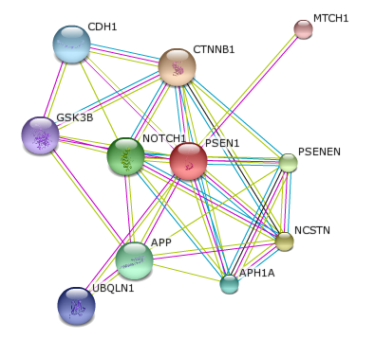
What proteins interact with PSEN1?
APH1A: Subunit of gamma-secretase complex
APP: Amyloid beta precursor protein
CDH1: Cell adhesion
CTNNB1: Regulation of cell adhesion
GSK3B: Cell signaling
MTCH1: Mitochondrial transporter
NCSTN: Subunit of gamma-secretase complex
NOTCH1: Receptor for membrane ligands
PSENEN: Subunit of gamma-secretase complex
UBQLN1: Promotes PSEN1 accumulation

Slide 11
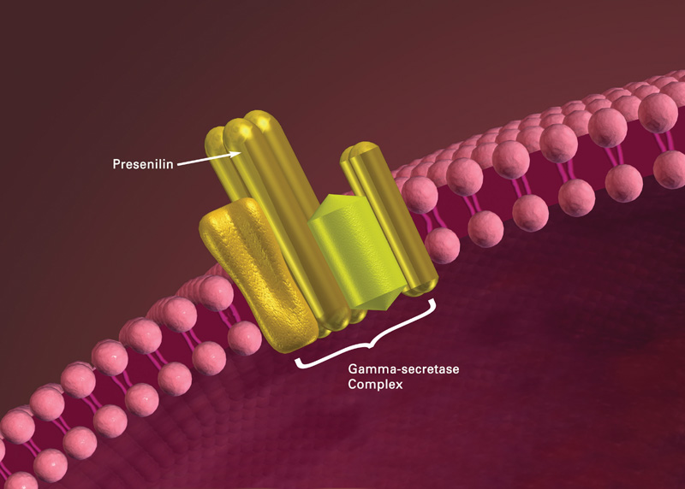
What is the gap in knowledge?
Presenilin
DOWNREGULATION
???
Gamma-Secretase Complex

Slide 12
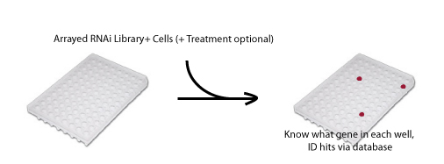
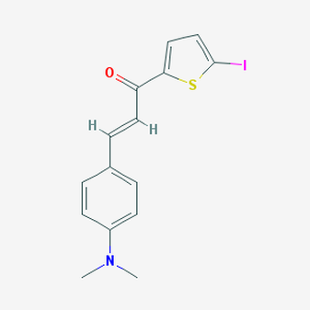
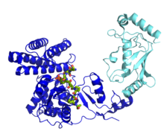
Long Term Goal: Discover if UBQLN1-mediated ubiquitination is required to regulate PSEN1 activity in regards to APP production.
Hypothesis 1:
A drug capable of inhibiting PSEN1 or UBQLN1 will reduce APP production
Hypothesis 3:
Ubiquitin ligases found crucial to neurotoxic protein accumulation
Hypothesis 2:
UBQLN1 and other ubiquitination-inducing proteins required for Alzheimer’s

Slide 13
Specific Aim 1: Isolate drug targets for wild type PSEN1 and UBQLN1
Approach:
Chemical Genetic Database
PSEN1
UBQLN1
Hypothesis: Drugs that inhibit either PSEN1 or UBQLN1 will suppress APP production and amyloid plaque formation.
Notes:
Match hypothesis to aim color

Slide 14
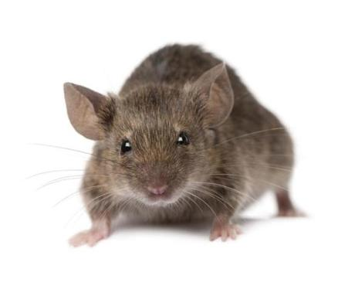
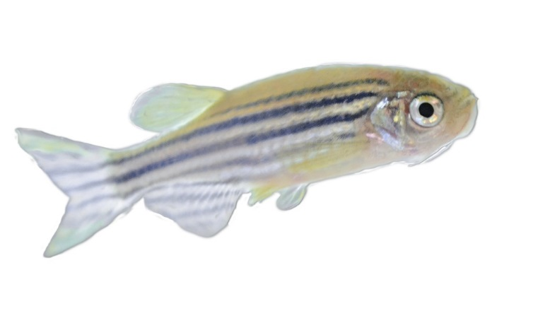
Specific Aim 2: Identify additional proteins involved with mutated PSEN1
Approach:
RNA interference Screen
RNAi screen
Hypothesis: UBQLN1 and other ubiquitination-inducing proteins will be found essential to Alzheimer’s development.
Notes:
Change to not red

Slide 15
Specific Aim 3: Recognize proteins that interact with PSEN1 and UBQLN1
Approach:
Yeast-2-Hybrid Screen
PSEN1
Yeast-2
Hybrid Screen
Bait Proteins
UBQLN1
Hypothesis: Ubiquitin ligases will be found crucial to the accumulation of neurotoxic proteins during Alzheimer’s.

Slide 16
What can be concluded about PSEN1?
Important regulatory protein
Interconnected to proteins of various functions
Leads to increased APP through gamma-secretase
Mutated overproduction leads to neurotoxicity observed in Alzheimer’s
PSEN1

Slide 17
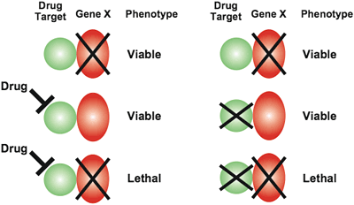
Where does the future of PSEN1 lead?
Further research on UBQLN1
Identify drug treatments for genes involved with Alzheimer’s
Cure Alzheimer’s Disease

Slide 18
References
Barnwell, E., Padmaraju, V., Baranello, R., Pacheco-Quinto, J., Crosson, C., Ablonczy, Z., … Sambamurti, K. (2014). Evidence of a Novel Mechanism for Partial γ-Secretase Inhibition Induced Paradoxical Increase in Secreted Amyloid β Protein. PLoS ONE, 9(3), e91531. doi:10.1371/journal.pone.0091531
Burns, A; Iliffe, S (5 February 2009). "Alzheimer's disease.". BMJ (Clinical research ed.) 338: b158.doi:10.1136/bmj.b158. PMID 19196745.
Cohen, J. (2013). Origin of Alzheimer's Gene Mutation Discovered. Obtained 02/16/2015 from http://www.news.ucsb.edu.
De Strooper, B. (2007). Loss-of-function presenilin mutations in Alzheimer disease. Talking Point on the role of presenilin mutations in Alzheimer disease.EMBO Reports, 8(2), 141–146. doi:10.1038/sj.embor.7400897
Li, X., Dang, S., Yan, C., Gong, X., Wang, J., Shi, Y. (2013). Structure of a presenilin family intramembrane aspartate protease. Nature, 493, 56-61.
Selkoe D (1994). "Cell biology of the amyloid beta-protein precursor and the mechanism of Alzheimer's disease". Annu. Rev. Cell Biol. 10: 373-403.doi:10.1146/annurev.cb.10.110194.002105.PMID 7888181.
St George-Hyslop P, Fraser P (January 2012). "Assembly of the presenilin γ-/ε-secretase complex". J. Neurochem. 120 Suppl 1: 84–8. doi:10.1111/j.1471-4159.2011.07505.x. PMID 22122073.
Wolfe, M. S. (2013). Toward the structure of presenilin/γ-secretase and homologs. Biochimica et Biophysica Acta, 1828(12), 2886–2897. doi:10.1016/j.bbamem.2013.04.015

