Slide 1
Alzheimer’s Disease and the influence of Presenilin 1
By Tony Cortez

Slide 2
What is Alzheimer’s Disease?

Slide 3
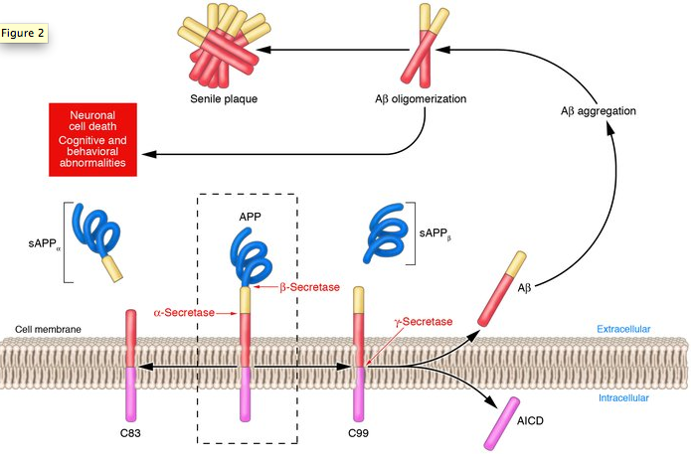
What goes wrong in Alzheimer’s?
Memory loss
Speech impediment
Disorientation
Notes:
No bullet points
Introduce what APP is
Pathway picture: http://www.jci.org/articles/view/25100/figure/2

Slide 4
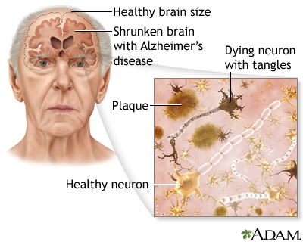
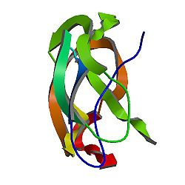
How is PSEN1 involved in Alzheimer’s?
Mutated PSEN1
Alzheimer’s Disease
Overproduction of APP

Slide 5
How is PSEN1 sorted with Gene Ontology?
PSEN1
Biological Process
Molecular Function
Cellular Component
Beta-amyloid formation
Cell differentiation
Neurotransmission regulation
Brain development
Transmembrane transport
Transcription factor binding
Kinase activity
Gamma-secretase complex
Dendritic roots
Regulatory protein complexes

Slide 6
How is PSEN1 sorted with Gene Ontology?
PSEN1
Biological Process
Molecular Function
Cellular Component
Beta-amyloid formation
Cell differentiation
Neurotransmission regulation
Brain development
Transmembrane transport
Transcription factor binding
Kinase activity
Gamma-secretase complex
Dendritic roots
Regulatory protein complexes

Slide 7
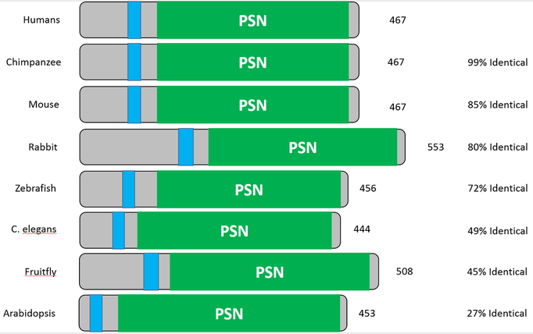
How is PSEN1 conserved across organisms?

Slide 8
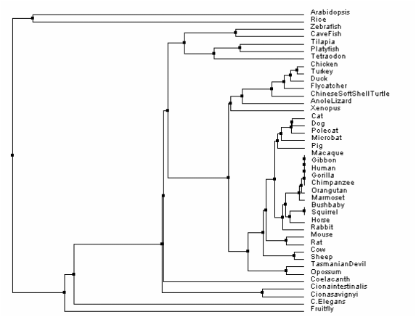
Phylogeny: How is PSEN1 conserved?
Average Distance Phylogeny Method

Slide 9
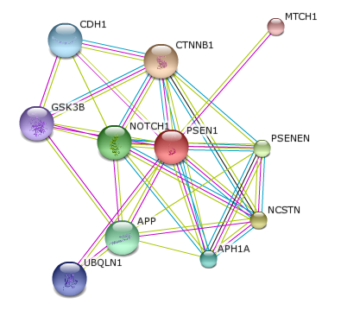
What proteins interact with PSEN1?
APH1A: Subunit of gamma-secretase complex
APP: Amyloid beta precursor protein
CDH1: Cell adhesion
CTNNB1: Regulation of cell adhesion
GSK3B: Cell signaling
MTCH1: Mitochondrial transporter
NCSTN: Subunit of gamma-secretase complex
NOTCH1: Receptor for membrane ligands
PSENEN: Subunit of gamma-secretase complex
UBQLN1: Promotes PSEN1 accumulation

Slide 10
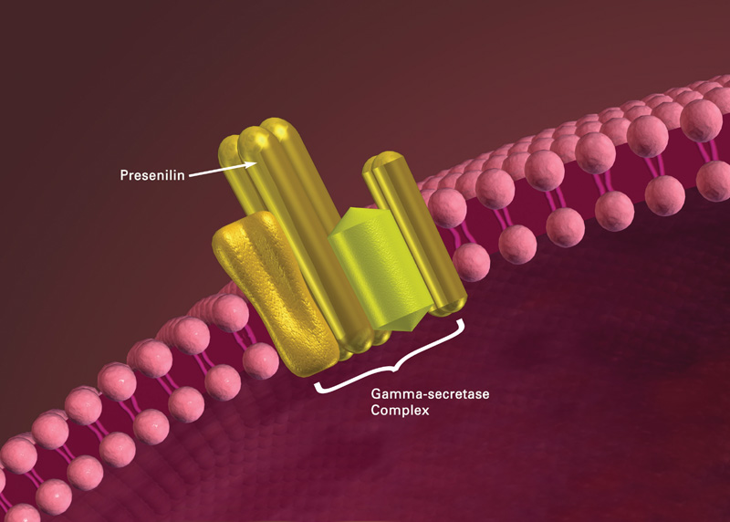
What is the gap in knowledge?
DOWNREGULATION
???
Presenilin
Gamma-Secretase Complex

Slide 11
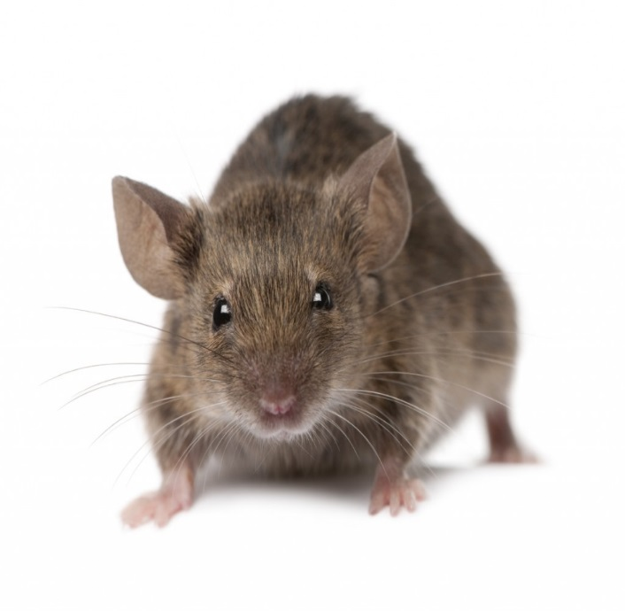
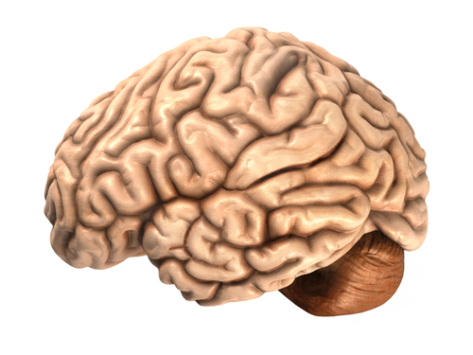
Hypothesis
Model Mouse with mutated PSEN1
Downregulation of gamma-secretase
Healthy brain and neural cells

Slide 12
Aim 1: To determine additional proteins targeted by PSEN1
Why: understand what other proteins are involved in Alzheimer’s Disease, allowing for more thorough understanding of how to treat Alzheimer’s
Approach: use GEO datasets to identify genes involved in the upregulation of APP and PSEN1—finding additional proteins targeted by presenilin protein (PSEN1)
Hypothesis: there will be additional proteins involved with Alzheimer’s and PSEN1, indicating the direction future experiments should undergo

Slide 13
Aim 2: Further understand the role of PSEN1
Why: isolate other regulatory genes that may contribute to increased neurotoxicity when controlling for PSEN1; will indicate what—in addition to PSEN1—may lead to the formation of amyloid plaques and neurofibrillary tangles
Approach: use an RNAi screen to inhibit genes with similar regulatory functions
Hypothesis: there will be other regulatory genes that cause increased neurotoxicity of the brain that must be understood in order to cure Alzheimer’s disease symptoms

Slide 14
Aim 3: To identify additional target genes of PSEN1
Why: RNA sequencing and tissue transcriptomics should identify additional target genes, for which certain chemicals may be applicable and utilized to prevent disease phenotypes
Approach: perform a bioassay, sorted with gene ontology, to isolate chemical genetic treatments through a target library for the various cell target genes
Hypothesis: treating the various target genes and proteins will eliminate Alzheimer’s disease symptoms

Slide 15
What can be concluded about PSEN?
Important regulatory protein
Interconnected to proteins of various functions
Leads to increased APP through gamma-secretase
Mutated overproduction leads to neurotoxicity observed in Alzheimer’s
PSEN1

Slide 16
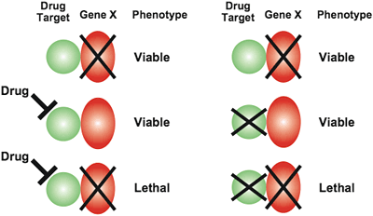
Where does the future of PSEN1 lead?
Further research on UBQLN1
Identify drug treatments for genes involved with Alzheimer’s
Cure Alzheimer’s Disease

Slide 17
References
Barnwell, E., Padmaraju, V., Baranello, R., Pacheco-Quinto, J., Crosson, C., Ablonczy, Z., … Sambamurti, K. (2014). Evidence of a Novel Mechanism for Partial γ-Secretase Inhibition Induced Paradoxical Increase in Secreted Amyloid β Protein. PLoS ONE, 9(3), e91531. doi:10.1371/journal.pone.0091531
Burns, A; Iliffe, S (5 February 2009). "Alzheimer's disease.". BMJ (Clinical research ed.) 338: b158.doi:10.1136/bmj.b158. PMID 19196745.
Cohen, J. (2013). Origin of Alzheimer's Gene Mutation Discovered. Obtained 02/16/2015 from http://www.news.ucsb.edu.
De Strooper, B. (2007). Loss-of-function presenilin mutations in Alzheimer disease. Talking Point on the role of presenilin mutations in Alzheimer disease.EMBO Reports, 8(2), 141–146. doi:10.1038/sj.embor.7400897
Li, X., Dang, S., Yan, C., Gong, X., Wang, J., Shi, Y. (2013). Structure of a presenilin family intramembrane aspartate protease. Nature, 493, 56-61.
Selkoe D (1994). "Cell biology of the amyloid beta-protein precursor and the mechanism of Alzheimer's disease". Annu. Rev. Cell Biol. 10: 373-403.doi:10.1146/annurev.cb.10.110194.002105.PMID 7888181.
St George-Hyslop P, Fraser P (January 2012). "Assembly of the presenilin γ-/ε-secretase complex". J. Neurochem. 120 Suppl 1: 84–8. doi:10.1111/j.1471-4159.2011.07505.x. PMID 22122073.
Wolfe, M. S. (2013). Toward the structure of presenilin/γ-secretase and homologs. Biochimica et Biophysica Acta, 1828(12), 2886–2897. doi:10.1016/j.bbamem.2013.04.015

