Slide 1
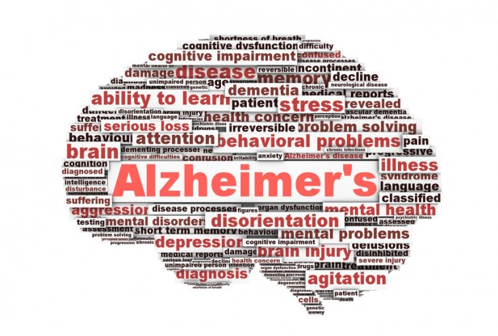
Alzheimer’s Disease and the influence of Presenilin 1
By Tony Cortez

Slide 2
What is Alzheimer’s Disease?
Notes:
I swapped the order of your slides. I would suggest starting out with an intro to Alzheimer’s, on this slide.

Slide 3
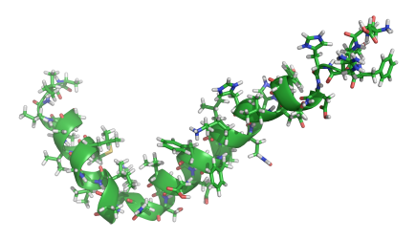
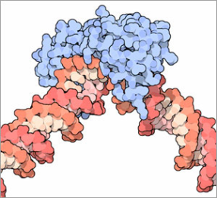
How is PSEN1 involved in Alzheimer’s?
Biological Process
Molecular Function
Cellular Component
Beta-amyloid formation
Cell differentiation
Neurotransmission regulation
Brain development
Transmembrane transport
Transcription factor binding
Kinase activity
Gamma-secretase complex
Dendritic roots
Regulatory protein complexes
Notes:
PSEN1- neuroregulatory gene, regulates APP production, controls amyloid plaque and neurofibrillary tangle formation

Slide 4
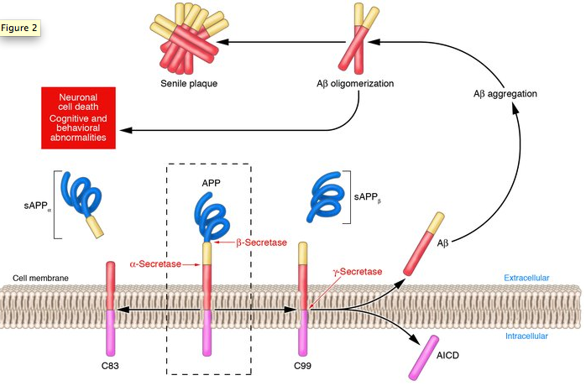
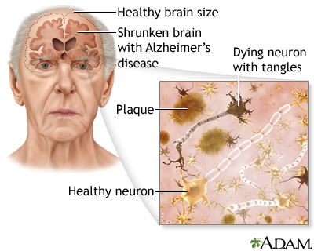
How is APP involved in Alzheimer’s?
Memory loss
Speech impediment
Disorientation
Notes:
After introducing Alzheimer’s, explain what goes wrong on a molecular/cellular level. I would use some combination of this slide and the next one. Maybe use the images from slide 4 with the boxes on the bottom of this slide. You mainly just need to introduce APP, because you use APP levels as a readout in your specific aims. I would avoid going into too much detail about gamma-secretase, etc.

Slide 5
How is PSEN1 conserved across organisms?
Transmembrane Domain
Presenilin Domain

Slide 6
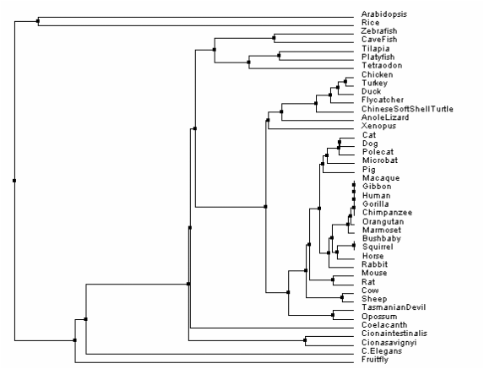
What is the phylogeny for PSEN1?
% Identity and Average Distance Phylogeny Method
Notes:
You could skip the phylogeny if you run long on time when you practice. The flow of the talk would not be disrupted at all.

Slide 7
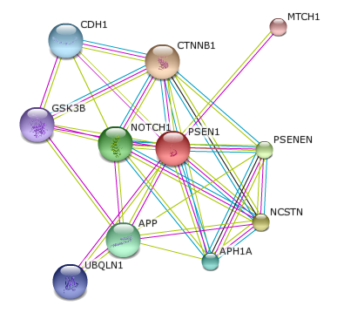
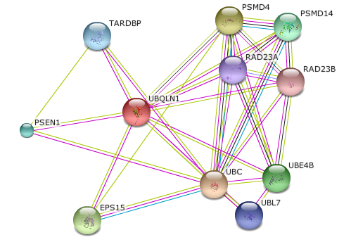
What proteins interact with PSEN1?
Proteasome
Cell Adhesion
DNA Binding
Cellular Transport
Cell Signaling
PSEN1 Over-accumulation
Gamma-secretase subunit
Growth Factor
Ubiquitination
PSEN1
Over-accumulation
Biological Process
Molecular Function
Cellular Component
Beta-amyloid formation
Transcription factor binding
Dendrites
Notes:
Can you take the STRING interaction network and group it to make this slide a bit less messy? Kassie Ford did this really well in her presentation, which you will see tomorrow. You can download her talk and take a look. You could easily group the gamma-secretase/APP-related things (APH1A, APP, NCSTN, PSENEN), the cell adhesion things (CDH1, CTNNB1), and the cell signaling things (GSK3B, NOTCH1) into separate classes, leaving only UBQLN1 and MTCH1 as “outliers.” This will make your slide much simpler and help to draw the focus to where it’s really important.

Slide 8
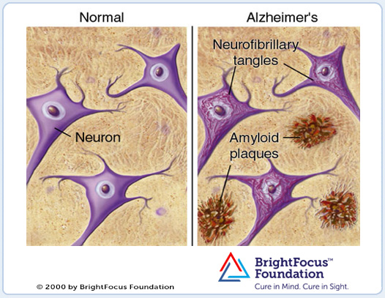
What is the gap in knowledge?
Unclear if the downregulation of UBQLN1 mediates plaque formation
Alzheimer’s Disease
Restored WT Function
Neurofibrillary Tangles
Improved cognitive function
Reverse disease symptoms
Healthy Neuron
Impaired memory
Disorientation
Speech impediment
Amyloid Plaques

Slide 9
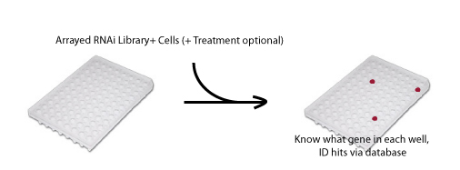
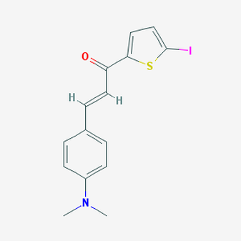
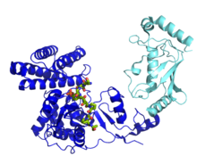
Long Term Goal: Discover if UBQLN1-mediated ubiquitination is required to regulate PSEN1 activity in regards to APP production.
Aim 1:
Identify a drug that inhibits UBQLN1 function of PSEN1 accumulation
Aim 3:
Identify phosphorylation sites in PSEN1 responsible for amyloid plaques
Aim 2:
Determine the importance of UBQLN1 and other ubiquitination-inducing proteins

Slide 10
Specific Aim 1:
Identify a drug that inhibits UBQLN1 function
of PSEN1 over-accumulation
Approach:
Chemical Genetic Database
UBQLN1
Compound CID 17757413
(E)-3-[4-(dimethylamino)phenyl]-1-(5-iodothiophen-2-yl)prop-2-en-1-one
Hypothesis: Drugs that inhibit UBQLN1 will suppress PSEN1 accumulation, APP production and amyloid plaque formation.
Notes:
As Ahna said in her email, you should expand your slides for each of your aims. You can talk about the aim and your approach on one slide, and the hypothesis and rationale on the next slide. You should also discuss what you expect to find, making some hypothetical data. Gina Castelvecchi from last year did a great job with this; download her talk and see how she presented her “results.” Also be prepared to talk about controls and experimental design, as you may get questions from the class about these things.

Slide 11
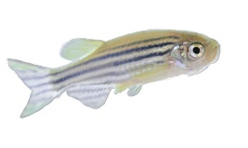
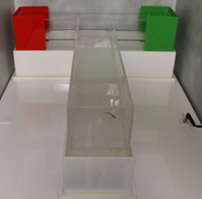
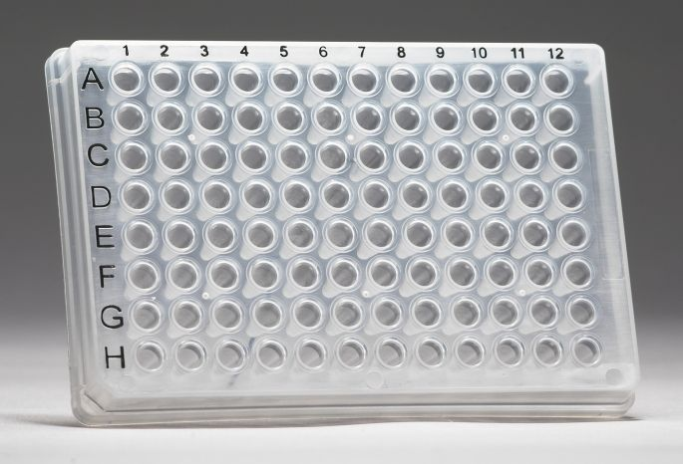
Specific Aim 1:
Direct target drug testing results
Direct target library
UBQLN4
-Drug
Memory Test
+Drug
Memory Test
-Drug
+Drug
WT
Passed!
Failed!
Mutated
PSEN1
Passed!
Failed!
No amyloid plaques!
Mutated
UBQLN4
Failed!
Passed!

Slide 12
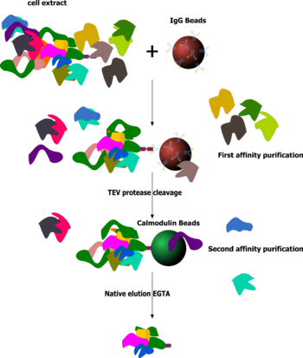
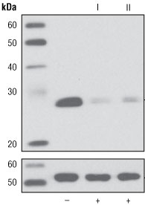
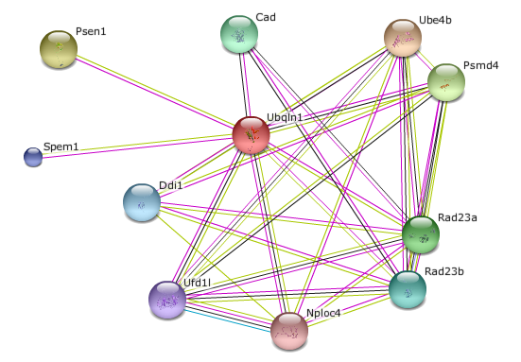
Specific Aim 2:
Identify proteins that regulate PSEN1
Approach:
Tandem Affinity Purification
TAP-tag UBQLN1
Identify brain-specific candidate proteins
Ube4b
Psmd4
Hypothesis: UBQLN1 and other ubiquitination-inducing proteins will be found essential to amyloid plaque formation.
Notes:
Same as for aim 1 slide.

Slide 13
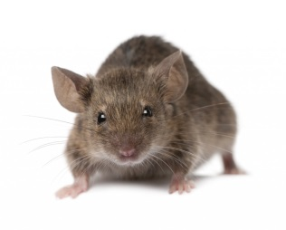
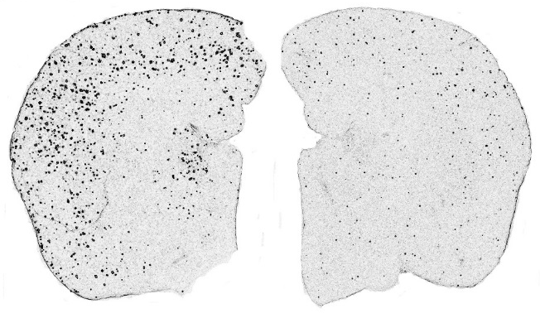
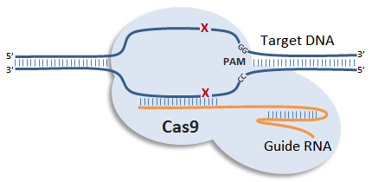
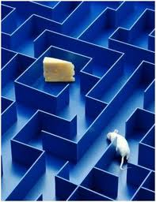
Specific Aim 2:
Observe plaque formation
Perform memory test
Knockout UBQLN1 binding proteins
Predicted
Results
Mutated
Psmd4
WT Mice
Memory Test
on WT
Memory Test
on mutant
No
Knockout
Passed!
Failed!
Amyloid plaques!
Knockout
PSEN1
Failed!
Failed!
Knockout
UBQLN1
Failed!
Failed!
Amyloid plaques!
Knockout
Psmd4
Failed!
Failed!
Notes:
Same as for aim 1 slide.

Slide 14
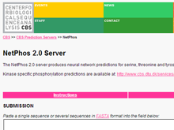
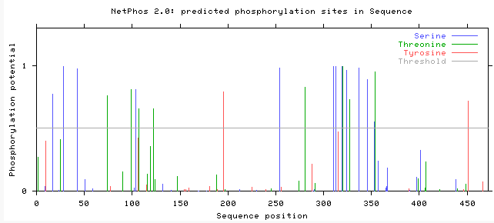
Specific Aim 3:
Determine conserved post-translational modifications in PSEN1
Hypothesis: Phosphorylation at certain amino acids are essential to regular PSEN1 function.
Notes:
Same as aims 1 & 2 slides.

Slide 15
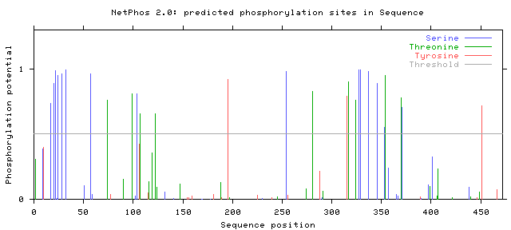
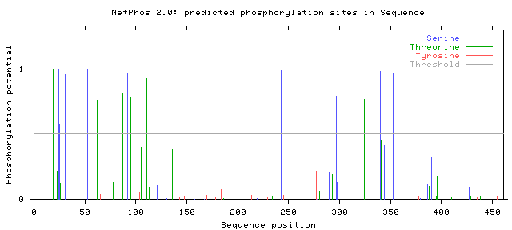
Specific Aim 3:
Serine-320 is the most conserved PTM
Humans
Mice
Zebrafish
Notes:
I hope to identify the most conserved ligase region between humans, mice and zebrafish to interpret which ligase is most important to Alzheimer’s.

Slide 16
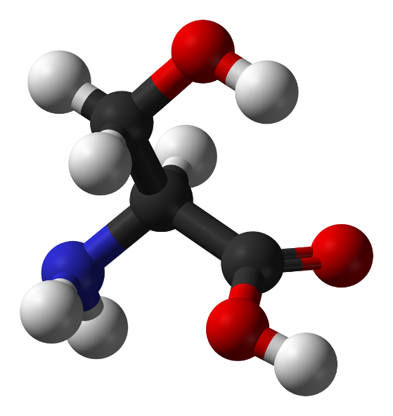
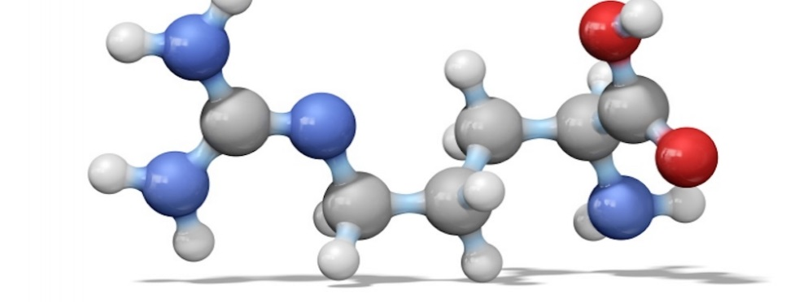
Specific Aim 3:
Predicted Results
CRISPR
Serine
Arginine
Amyloid plaque formation!
Fail
memory test!
Notes:
I hope to identify the most conserved ligase region between humans, mice and zebrafish to interpret which ligase is most important to Alzheimer’s.

Slide 17
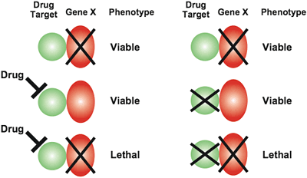
Where does the future of PSEN1 lead?
Further research on UBQLN1
Identify drug treatments for genes involved with Alzheimer’s
Cure Alzheimer’s Disease

Slide 18
References
Barnwell, E., Padmaraju, V., Baranello, R., Pacheco-Quinto, J., Crosson, C., Ablonczy, Z., … Sambamurti, K. (2014). Evidence of a Novel Mechanism for Partial γ-Secretase Inhibition Induced Paradoxical Increase in Secreted Amyloid β Protein. PLoS ONE, 9(3), e91531. doi:10.1371/journal.pone.0091531
Burns, A; Iliffe, S (5 February 2009). "Alzheimer's disease.". BMJ (Clinical research ed.) 338: b158.doi:10.1136/bmj.b158. PMID 19196745.
Cohen, J. (2013). Origin of Alzheimer's Gene Mutation Discovered. Obtained 02/16/2015 from http://www.news.ucsb.edu.
De Strooper, B. (2007). Loss-of-function presenilin mutations in Alzheimer disease. Talking Point on the role of presenilin mutations in Alzheimer disease.EMBO Reports, 8(2), 141–146. doi:10.1038/sj.embor.7400897
Li, X., Dang, S., Yan, C., Gong, X., Wang, J., Shi, Y. (2013). Structure of a presenilin family intramembrane aspartate protease. Nature, 493, 56-61.
Selkoe D (1994). "Cell biology of the amyloid beta-protein precursor and the mechanism of Alzheimer's disease". Annu. Rev. Cell Biol. 10: 373-403.doi:10.1146/annurev.cb.10.110194.002105.PMID 7888181.
St George-Hyslop P, Fraser P (January 2012). "Assembly of the presenilin γ-/ε-secretase complex". J. Neurochem. 120 Suppl 1: 84–8. doi:10.1111/j.1471-4159.2011.07505.x. PMID 22122073.
Wolfe, M. S. (2013). Toward the structure of presenilin/γ-secretase and homologs. Biochimica et Biophysica Acta, 1828(12), 2886–2897. doi:10.1016/j.bbamem.2013.04.015

Slide 19
QUESTIONS?

